Slide 1
Objectives
In this session, you will learn to:
  Write a program that uses command-line arguments and system properties
  Examine the Properties class
  Serialize and deserialize objects
  Distinguish readers and writers from streams

Slide 2
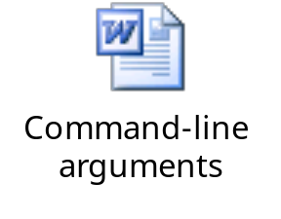
Command-Line Arguments
Command-line arguments are the parameters passed to a Java application at run time.
Each command-line argument is stored in an array of String objects that is passed to the static main method.
Let us understand the concept of command-line arguments by using the embedded document.

Slide 3
System Properties
System properties are another mechanism used to parameterize a program at runtime.
The System.getProperties() method returns the system properties object.
The System.getProperty(String) method returns the string value of the property named in the String parameter.
The System.getProperty(String,String) method enables you to supply a default string value (second parameter), which is returned if the named property does not exist.

Slide 4
The Properties Class
An object of the Properties class contains a mapping between property names (String) and values (String).
It has two main methods for retrieving a property value:
  getProperty(String)
  getProperty(String,String)

Slide 5

I/O Stream Fundamentals
A stream is a flow of data from a source to a sink. The program is one end of that stream, and some other node (for example, a file) is the other end.
Sources and sinks are also called input streams and output streams, respectively. Read operation is performed from an input stream and write operation is performed on an output stream.
The following figure displays the fundamental stream classes.

Slide 6
Data Within Streams
Java supports two types of data in streams:
  Raw bytes
  Unicode characters
The term stream refers to byte streams and the terms reader and writer refer to character streams.
Character input streams are implemented by subclasses of the Reader class and character output streams are implemented by subclasses of the Writer class.
Byte input streams are implemented by subclasses of the InputStream class and byte output streams are implemented by subclasses of the OutputStream class.

Slide 7
Byte Streams
The InputStream methods are:
  int read()
  int read(byte[] buffer)
  int read(byte[] buffer, int offset, int length)
  void close()
  int available()
  long skip(long n)
  boolean markSupported()
  void mark(int readlimit)
  void reset()

Slide 8
Byte Streams (Contd.)
The OutputStream methods are:
  void write(int)
  void write(byte[] buffer)
  void write(byte[] buffer, int offset, int length)
  void close()
  void flush()

Slide 9
Character Streams
The Reader methods are:
  int read()
  int read(char[] cbuf)
  int read(char[] cbuf, int offset, int length)
  void close()
  boolean ready()
  long skip(long n)
  boolean markSupported()
  void mark(int readAheadLimit)
  void reset()

Slide 10
Character Streams (Contd.)
The Writer methods are:
  void write(int c)
  void write(char[] cbuf)
  void write(char[] cbuf, int offset, int length)
  void write(String string)
  void write(String string, int offset, int length)
  void close()
  void flush()

Slide 11
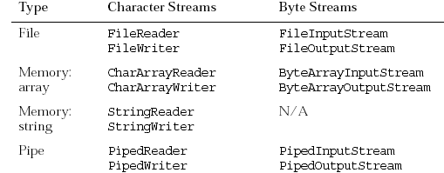
Node Streams
There are three fundamental types of nodes:
  Files
  Memory
  Pipes
The following figure displays the types of nodes streams.

Slide 12
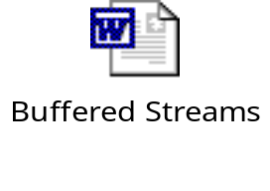
Buffered Streams
Let us understand how to use buffered streams by using the embedded document.

Slide 13
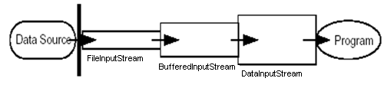
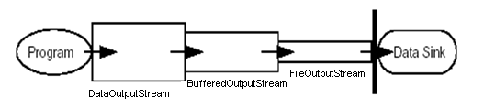
I/O Stream Chaining
A program rarely uses a single stream object. Instead, it chains a series of streams together to process the data.
The following figure displays an example of an input stream.
The following figure displays an example of an output stream.

Slide 14
Processing Streams
A processing stream performs some sort of conversion on another stream.
Processing streams are also known as filter streams.
A filter input stream is created with a connection to an existing input stream.

Slide 15
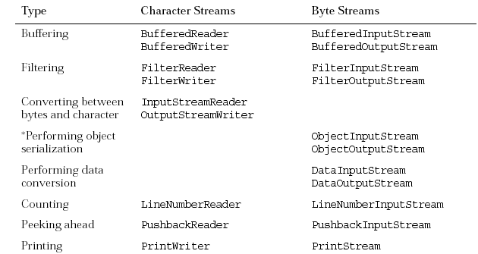
Processing Streams (Contd.)
The following figure displays the built-in processing streams that are included in the java.io package.

Slide 16
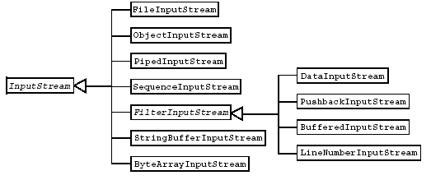
Basic Byte Stream Classes
The following figure displays the hierarchy of input byte stream classes in the java.io package.

Slide 17
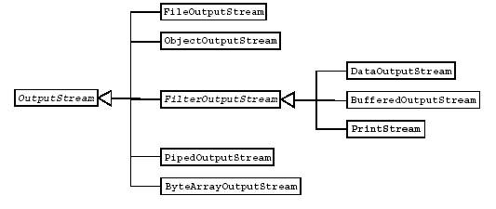
Basic Byte Stream Classes (Contd.)
The following figure displays the hierarchy of output byte stream classes in the java.io package.

Slide 18
Basic Byte Stream Classes (Contd.)
The FileInputStream and FileOutputStream classes are node streams, they use disk files.
The BufferedInputStream and BufferedOutputStream class filter streams increase the efficiency of I/O operations.
A PipedInputStream object in one thread receives its input from a complementary PipedOutputStream object in another thread.
The DataInputStream and DataOutputStream called filter streams enable reading and writing of Java primitive types and some special formats using streams.
The ObjectInputStream and ObjectOutputstream classes enable reading from and writing Java objects to streams.

Slide 19
Serialization
Serialization is a mechanism for saving the objects as a sequence of bytes and later, when needed, rebuilding the byte sequence back into a copy of the object.
For objects of a specific class to be serializable, the class must implement the java.io.Serializable interface.
The Serializable interface has no methods and only serves as a marker that indicates that the class that implements the interface can be considered for serialization.

Slide 20
Serialization and Object Graphs
When an object is serialized, only the fields of the object are preserved; methods and constructors are not part of the serialized stream.
When a field is a reference to an object, the fields of that referenced object are also serialized if that object’s class is serializable.
The tree, or structure of an object’s fields, including these sub-objects, constitutes the object graph.
If the object graph contains a non-serializable object reference, the object can still be serialized if the reference is marked with the transient keyword.

Slide 21
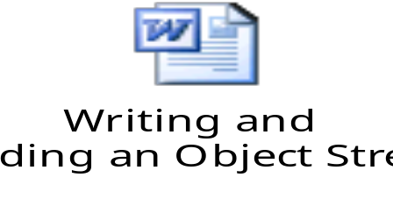
Writing and Reading an Object Stream
Let us understand how to write and read an object to a stream by using the embedded document.

Slide 22
Summary
In this session, you learned that:
  A program can be parameterized by command-line arguments and system properties.
  System properties are another mechanism used to parameterize a program at runtime.
  The System.getProperties() method returns the system properties object.
  A stream is a flow of data from a source to a sink.
  Sources and sinks are also called input streams and output streams, respectively. Read operation is performed from an input stream and write operation is performed on an output stream.
  The term stream refers to byte streams and the terms reader and writer refer to character streams.

Slide 23
Summary (Contd.)
  Processing streams are also known as filter streams.
  Serialization is a mechanism for saving the objects as a sequence of bytes and later, when needed, rebuilding the byte sequence back into a copy of the object.

